Slide 1
Unit 7: structure
PROG0101 Fundamentals of Programming
1

Slide 2
Structure
A structure is a user defined data type in C. A structure creates a data type that can be used to group items of possibly different types into a single type.
Difference Between Array and Structure
An array is a collection of variables of same data type whereas a structure is a collection of variables of different data type.

Slide 3
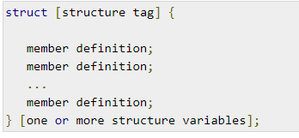
Defining a Structure
To define a structure, you must use the struct statement. The struct statement defines a new data type, with more than one member. The format of the struct statement is as follows −
The structure tag is optional and each member definition is a normal variable definition, such as int i; or float f; or any other valid variable definition. At the end of the structure's definition, before the final semicolon, you can specify one or more structure variables but it is optional.

Slide 4
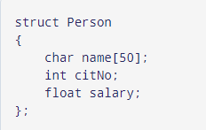
Example of Structure: Here, a derived type struct Person is defined.
.

Slide 5
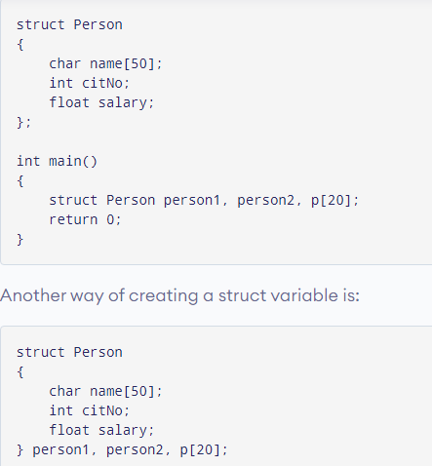
Create struct variables
When a struct type is declared, no storage or memory is allocated. To allocate memory of a given structure type and work with it, we need to create variables.

Slide 6
Accessing Structure Members
There are two types of operators used for accessing members of a structure.
. – Member Operator
-> - Structure pointer operator
Suppose, you want to access the salary of person2.
person2.salary

Slide 7
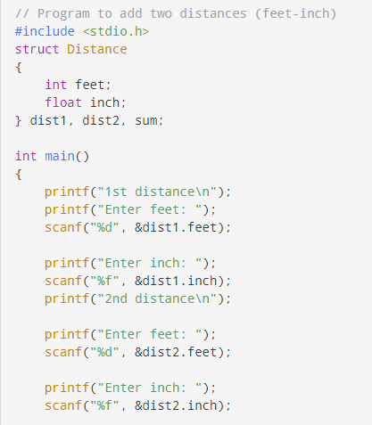
Example:

Slide 8
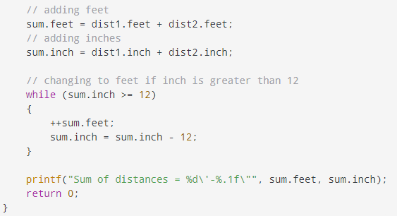
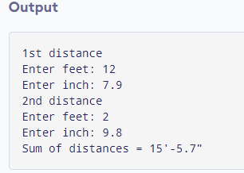

Slide 9
Array of Structure
C Structure is collection of different datatypes ( variables ) which are grouped together.
Whereas, array of structures is nothing but collection of structures. This is also called as structure array in C.

Slide 10
EXAMPLE PROGRAM FOR ARRAY OF STRUCTURES IN C:
This program is used to store and access “id, name and percentage” for 3 students.
Structure array is used in this program to store and display records for many students. You can store “n” number of students record by declaring structure variable as ‘struct student record[n]“, where n can be 1000 or 5000 etc.

Slide 11
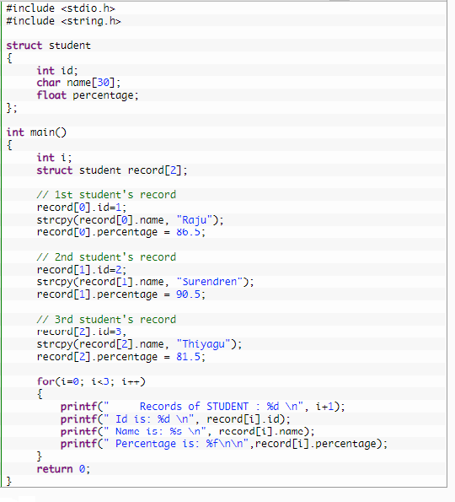
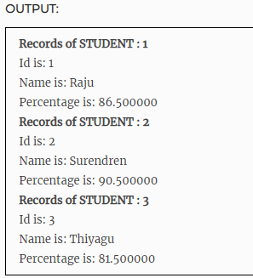

Slide 12
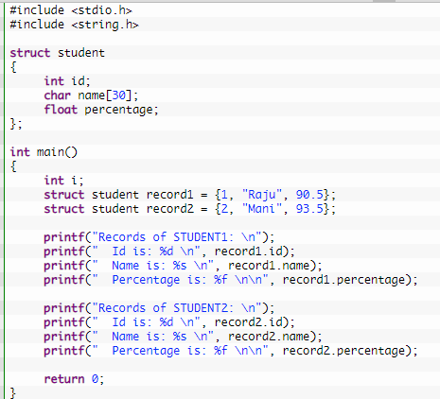
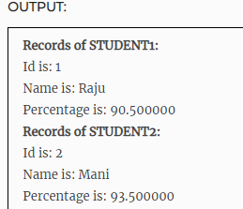
EXAMPLE PROGRAM FOR DECLARING MANY STRUCTURE VARIABLE IN C:
In this program, two structure variables “record1″ and “record2″ are declared for same structure and different values are assigned for both structure variables. Separate memory is allocated for both structure variables to store the data.

